Slide 1
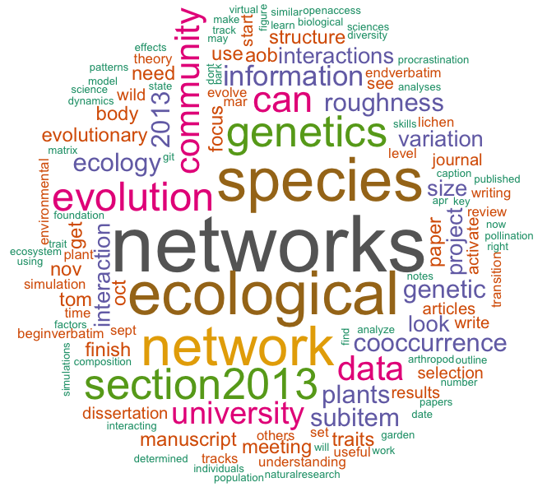

Slide 2
Evolution of Ecological Networks
Matthew K. Lau

